Slide 1

CpSc 360: Network and Network Programming
Final Review

Slide 2

The Domain Name System
The domain name system is usually used to translate a host name into an IP address .
Domain names comprise a hierarchy so that names are unique, yet easy to remember.

Slide 3
DNS Organization
Distributed Database
  The organization that owns a domain name is responsible for running a DNS server that can provide the mapping between hostnames within the domain to IP addresses.
  So - some machine run by Clemson is responsible for everything within the clemson.edu domain.
  There is one primary server for a domain, and typically a number of secondary servers containing replicated databases.

Slide 4
DNS Clients
A DNS client is called a resolver.
A call to gethostbyname()is handled by a resolver (typically part of the client).
Most Unix workstations have the file /etc/resolv.conf that contains the local domain and the addresses of DNS servers for that domain.

Slide 5
DNS Servers
Servers handle requests for their domain directly.
Servers handle requests for other domains by contacting remote DNS server(s).
Servers cache external mappings.
If a server is asked to provide the mapping for a host outside it’s domain (and the mapping is not in the server cache):
  The server finds a nameserver for the target domain.
  The server asks the nameserver to provide the host name to IP translation.
To find the right nameserver, use DNS!

Slide 6
DNS Data
DNS databases contain more than just hostname-to-address records:
  Name server records NS
  Hostname aliases CNAME
  Mail Exchangers MX
  Host Information HINFO

Slide 7
Server Operation
If a server has no clue about where to find the address for a hostname, ask the root server.
The root server will tell you what nameserver to contact.
A request may get forwarded a few times.

Slide 8
Typical Configuration
Application
function
call
function
return
UDP request
Local name server
Other name server
Resolver
UDP reply
resolver configuration files

Slide 9
General Options
Protocol independent options.
Handled by the generic socket system code.
Some general options are supported only by specific types of sockets (SOCK_DGRAM, SOCK_STREAM).
Some Generic Options
  SO_BROADCAST
  SO_DONTROUTE
  SO_ERROR
  SO_KEEPALIVE
  SO_LINGER
  SO_RCVBUF,SO_SNDBUF
  SO_REUSEADDR

Slide 10
SO_KEEPALIVE
Boolean option: enabled means that STREAM sockets should send a probe to peer if no data flow for a “long time”.
  A probe is a TCP segment to which the peer must respond
Used by TCP - allows a process to determine whether peer process/host has crashed.
Three Scenarios:
  Peer responds with Ack. The application is not notified. TCP will send another prove following another two hours of inactivity.
  Peer responds with RST. The socket’s pending error is set to ECONNRESET and the socket is closed.
  No response from peer. Berkeley-derived TCPs send 8 additional probes, 75 s apart. If no response at all, the socket’s pending error is set to ETIMEOUT and the socket is closed.

Slide 11
SO_LINGER
Value is of type:
struct linger {
  int l_onoff; /* 0 = off */
  int l_linger; /* time in seconds */
};
The option specifies how the close function operates for a connection-oriented protocol.
Used to control whether and how long a call to close will wait for pending ACKS.

Slide 12
SO_LINGER usage
By default, calling close() on a TCP socket will return immediately.
The closing process has no way of knowing whether or not the peer received all data.
Setting SO_LINGER means the closing process can determine that the peer machine has received the data (but not that the data has been read() !).
  l_onoff = 0 // option off
  l_onoff is nonzero and l_linger is zero, abort the connection when it is closed.
  Both l_onoff and l_linger are nonzero. The kernel will linger when the socket is closed.

Slide 13
Default
Client
Server
write
data
close
close return
FIN
Data queued by TCP
ACK of data and FIN
Application reads queued data and FIN
close
FIN
ACK of data and FIN

Slide 14
close with SO_LINGER
Client
Server
write
data
close
FIN
Data queued by TCP
ACK of data and FIN
Application reads queued data and FIN
close return
close
FIN
ACK of data and FIN

Slide 15
Using shutdown/read to know the peer has received the data
Client
Server
write
data
shutdown
read block
FIN
Data queued by TCP
ACK of data and FIN
Application reads queued data and FIN
close
FIN
read return 0
ACK of data and FIN

Slide 16
Application ACK
Client
Server
write
data
read block
Data queued by TCP
ACK of data
Application reads and process data
1 byte data (application ACK)
write application ACK
read return 1
close
close return
ACK of data and FIN
EOF to application
close
FIN
ACK of FIN

Slide 17
Unix process creation: Fork()
System call fork() is used to create processes. It takes no arguments and returns a process ID.
The purpose of fork() is to create a new process, which becomes the child process of the caller.
After a new child process is created, both processes will execute the next instruction following the fork() system call.

Slide 18
Parent or Child?
If fork() returns a negative value, the creation of a child process was unsuccessful.
fork() returns a zero to the newly created child process.
fork() returns a positive value, the process ID of the child process, to the parent. The returned process ID is of type pid_t defined in sys/types.h. Normally, the process ID is an integer.
The child process can use function getpid() to retrieve the process ID assigned to this process.

Slide 19
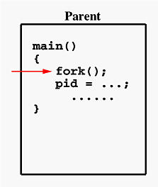
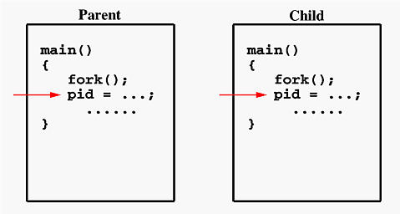
Process Duplication
If the call to fork() is executed successfully, Unix will
make two identical copies of address spaces, one for the parent and the other for the child.
Both processes will start their execution at the next statement following the fork() call. In this case, both processes will start their execution at the assignment statement as shown below:

Slide 20
wait()
Purpose: Wait for child process to complete.
This function blocks the calling process until one of its child processes exits or a signal is received.
wait() takes the address of an integer variable and returns the process ID of the completed process.
Some flags that indicate the completion status of the child process are passed back with the integer pointer.
  If there are at least one child processes running when the call to wait() is made, the caller will be blocked until one of its child processes exits. At that moment, the caller resumes its execution.
  If there is no child process running when the call to wait() is made, then this wait() has no effect at all. That is, it is as if no wait() is there.

Slide 21
Zombie Process
When a child exits, its process becomes a "zombie" until its parent process either dies or calls wait() for it.
By a "zombie", we mean that it takes up no resources, and doesn't run, but it is just being maintained by the operating system so that when the parent calls wait(), it will get the proper information.
wait() returns whenever a child exits. If a process has more than one child, then you can't force wait() to wait for a specific child. You simply get whichever child exits first.

Slide 22
waitpid()
pid_t waitpid(pid_t pid, int *statloc, int options);
waitpid() gives us more control over which process to wait for and whether or not to block.
the pid argument lets us specify the process ID. -1 means wait for first child to terminate.
the options argument lets us specify additional options.
The most common option is WNOHANG. This option tells the kernel not to block if there is no terminated children.

Slide 23
exec() variants
execve(char *path, char **argv, char **envp).
execl(char *path, char *arg0, char *arg1, ..., char *argn, NULL): This uses your current envp, and lets you specify the argv as parameters, rather than building an array of pointers. Path must specify the path name exactly.
execv(char *path, char **argv): This is just like execve, but uses your current envp.
execle(char *path, char *arg0, char *arg1, ..., char *argn, NULL, char **envp): This is just like execl, but you must specify envp.
execlp(char *path, char *arg0, char *arg1, ..., char *argn, NULL): This is just like execl, except that if path is a relative filename, then the directories in your PATH variable will be searched to find path.
execvp(char *path, char **argv): This is just like execv, except that the PATH variable will be searched to find path.

Slide 24
The difference of six exec() function
Whether the program file to execute is specified by a filename or a pathname
Whether the arguments to the new program are listed one by one or referenced through an array of pointers
Whether the environment of the calling process is passed to the new program or whether a new environment is specified.

Slide 25
What happened?
Execve() assumes that path is the name of an executable file. Argv is an array of null-terminated strings, such that the last element is NULL, and envp is another null-terminated array of null-terminated strings.
Execve() overwrites the current process so that it executes the file in path with the arguments in argv, and the environment variables in envp.
Execve() does not return unless it encounters an error, such as the file in "path" not existing, or not being an executable file.

Slide 26

Daemons
A daemon is a process that:
  runs in the background
  not associated with any terminal
    output doesn't end up in another session.
    terminal generated signals (^C) aren't received.
Unix systems typically have many daemon processes.
Most servers run as a daemon process.
  During system startup, many daemons are started by the system initialization scripts.
  Daemons can be started from user terminal, either in the foreground or in the background.

Slide 27
Daemon Output
No terminal - must use something else:
  file system
  central logging facility
Syslog is often used - provides central repository for system logging.
Syslog was developed in the 1980s by Eric Allman as part of the Sendmail project

Slide 28

Syslog service
syslogd daemon provides system logging services to "clients".
Simple API for "clients"
  A library provided by O.S.
Centralized Administration: A system administrator can control logging functions by specifying:
  where messages should go
  what kinds of messages are important
  what can be ignored

Slide 29
How to create daemons?
Call fork() and have the parent exit, which will force a process to run in the background.
To disassociate a process from any controlling terminal.
  Call setsid() and then fork() again.
    setsid() is a system call that create a new session. Then, the process becomes the session leader of the new session.
    This will guarantee that the daemon cannot automatically acquire a controlling terminal.

Slide 30
Example
#include <sys/types.h>
#include <sys/stat.h>
#include <stdio.h>
#include <stdlib.h>
#include <fcntl.h>
#include <errno.h>
#include <unistd.h>
#include <syslog.h>
#include <string.h>
int main(void) {
/* Our process ID and Session ID */
pid_t pid, sid;
/* Fork off the parent process */
pid = fork();
if (pid < 0) {
exit(EXIT_FAILURE);
}
/* If we got a good PID, then
we can exit the parent process. */
if (pid > 0) {
exit(EXIT_SUCCESS);
}

Slide 31
Example
/* Create a new SID for the child process */
sid = setsid();
if (sid < 0) {
/* Log the failure */
exit(EXIT_FAILURE);
}
signal(SIGHUP, SIG_IGN);
if((pid=fork())<0)
{
return (-1);
}
else if(pid)
{
exit(EXIT_SUCCESS); /** child 1 terminated */
}
daemon_proc = 1 /* for err function */

Slide 32
Daemon initialization
Daemons should close all unnecessary descriptors
  often including stdin, stdout, stderr.
Get set up for using syslog
  Call openlog()
Often change working directory.

Slide 33
Example
/* Change the current working directory to root*/
if ((chdir("/")) < 0) {
/* Log the failure */
exit(EXIT_FAILURE);
}
/* Close out the standard file descriptors */
for (i=0;i< MAXFD; i++)
{
close(i);
}
/* redirect stdin, stdout, stderr to /dev/null */
open (“/dev/null”, O_RDONLY);
open (“/dev/null”, O_RDWR);
open (“/dev/null”, o_RDWR);
openlog(pname, LOG_PID), facility);
/* Daemon-specific initialization goes here */
/* The Big Loop */
while (1) {
/* Do some task here ... */
sleep(30); /* wait 30 seconds */
}
exit(EXIT_SUCCESS);
}

Slide 34
I/O Models
Two phase for an input operation
  Waiting for the data to be ready
  Copying the data from the kernel to the process
I/O models
  Blocking I/O
  Nonblocking I/O
  I/O multiplexing
  Signal driven I/O
  Asynchronous I/O

Slide 35
Blocking I/O Model
Application
Kernel
system call
no datagram ready
recvfrom
wait for data
process blocks in call to recvfrom
datagram ready
copy datagram
copy data from kernel to user
return OK
copy complete
process datagram

Slide 36
Nonblocking I/O Model
Application
Kernel
system call
recvfrom
no datagram ready
EWOULDBLOCK
system call
wait for data
recvfrom
no datagram ready
process repeatedly calls recvfrom, wait for an OK return (polling)
EWOULDBLOCK
system call
recvfrom
datagram ready
copy datagram
copy data from kernel to user
return OK
copy complete
process datagram

Slide 37
I/O Multiplexing Model
Application
Kernel
system call
select
no datagram ready
process blocks in call to select, waiting for one of possible many sockets to become readable
wait for data
return readable
datagram ready
system call
recvfrom
copy datagram
process blocks while data copied into application buffer
copy data from kernel to user
return OK
copy complete
process datagram

Slide 38
Signal-Driven I/O Model
Application
Kernel
sigaction system call
establish SIGIO signal handler
process continue executing
return
wait for data
signal handler
deliver SIGIO
datagram ready
process blocks while data copied into application buffer
system call
recvfrom
copy datagram
copy data from kernel to user
return OK
copy complete
process datagram

Slide 39
Asynchronous I/O Model
Application
Kernel
sigaction system call
aio_read
no datagram ready
return
wait for data
process continue executing
datagram ready
copy datagram
copy data from kernel to user
signal handler
deliver signal
copy complete
specified in aio_read
process datagram

Slide 40
Comparison of the five I/O models
blocking | Nonblocking | I/O multiplexing | Signal-driven I/O | Asynchronous I/O
initiate | Check Check Check Check Check Check Check Check | check |  | initiate
 |  | Ready initiate | Notification initiate
complete | complete | complete | complete | notification
wait for data
blocked
blocked
copy data from kernel to user
blocked
blocked
blocked
1st phase handled differently, 2nd phase handled the same (blocked in call to recvfrom)
handles both phases

Slide 41
Comparison of the five I/O models
A synchronous I/O operation causes the requesting process to be blocked until that I/O operation completes.
  Blocking
  Nonblocking
  I/O multiplexing
  Signal-driven
An asynchronous I/O operation does not cause the requesting process to be blocked.

Slide 42
select()
This function allows the process to instruct the kernel to wait for any one of multiple events to occur and to wake up the process only when one or more these events occurs or when a specified time has passed.
The select() system call allows us to use blocking I/O on a set of descriptors (file, socket, …).
For example, we can ask select to notify us when data is available for reading on either STDIN or a TCP socket.

Slide 43
select()
#include <sys/select.h>
#include <sys/time.h>
int select( int maxfd,
fd_set *readset,
fd_set *writeset,
fd_set *excepset,
const struct timeval *timeout);
maxfd: highest number assigned to a descriptor+1.
readset: set of descriptors we want to read from.
writeset: set of descriptors we want to write to.
excepset: set of descriptors to watch for exceptions.
timeout: maximum time select should wait

Slide 44
struct timeval
struct timeval {
  long tv_sec; /* seconds */
  long tv_usec; /* microseconds */
}
Wait forever – return only when one of the specified descriptors is ready for I/O.
  set null pointer.
Wait up to fixed amount of time - return only when one of the specified descriptors is ready for I/O, but don’t wait beyond timeval.
struct timeval max = {1,0};/* 1 second */
Do not wait at all – return immediately after checking the descriptor. This is called polling.
struct timeval max = {0,0};

Slide 45
Using select()
Create fd_set
Clear the whole thing with FD_ZERO
Add each descriptor you want to watch using FD_SET.
Call select
when select returns, use FD_ISSET to see if I/O is possible on each descriptor.

Slide 46
Threads vs. Processes
fork is expensive (memory and time)
  Memory is copied from parent to child.
  the process takes long time.
IPC is required to pass information between the parent and child after the fork.
  Passing information from parent to child before the fork is easy, but returning information from child to parent takes more work.
Threads are “light weighted processes”. All thread within a process share the same global memory.
Problem is inter-thread synchronization.

Slide 47
fork()
Process A
Global
Variables
fork()
Process B
Code
Global
Variables
Stack
Code
Stack

Slide 48
pthread_create()
Process A
Thread 1
Global
Variables
pthread_create()
Code
Process A
Thread 2
Stack
Stack

Slide 49
Multiple Threads
All threads within a process share:
  Process Instructions.
  Most data.
  Open files (e.g., descriptors).
  Signal handlers and signal dispositions.
  Current working directory.
  User and Group IDs.
Each thread individually owns:
  Thread ID
  Set of registers.
  Stack (for local variable and return addresses)
  errno
  Signal mask
  Priority
Threads within the same process can communicate using shared memory.
  Must be done carefully!

Slide 50
Posix Threads
We will focus on Posix Threads - most widely supported threads programming API.
Solaris - you need to link with “-lpthread”

Slide 51
Thread Creation
  # include <pthread.h>
  int pthread_create(
  pthread_t *tid,
  const pthread_attr_t *attr,
  void *(*func)(void *),
  void *arg);
func is the function to be called.
When func() returns the thread is terminated.
on success, return 0, otherwise return a positive error number.
Thread ID is returned in tid

Slide 52
pthread_t *tid
Each thread within a process is identified by a thread ID.
On successful creation of a new thread, its ID is returned through the pointer tid.
Each thread has a unique ID, a thread can find out it's ID by calling pthread_self().
Thread IDs are of type pthread_t which is usually an unsigned int. When debugging, it's often useful to do something like this:
printf("Thread %u:\ n",pthread_self());

Slide 53
Thread Arguments
When func() is called the value arg specified in the call to pthread_create() is passed as a parameter.
func can have only 1 parameter, and it can't be larger than the size of a void *.
Complex parameters can be passed by creating a structure and passing the address of the structure.
The structure can't be a local variable (of the function calling pthread_create)!!
  threads have different stacks!
Notice the declaration of func and arg. The function takes one argument, a generic pointer (void *), and returns a generic pointer (void*). So we can pass in any data structure and return anything we want from the thread.

Slide 54
Thread args example
struct { int x,y } two_ints;
void *blah( void *arg) {
struct two_ints *foo
= (struct two_ints *) arg;
printf("%u sum of %d and %d is %d\n",
pthread_self(), foo->x, foo->y,
foo->x+foo->y);
return(NULL);
}

Slide 55
Thread Lifespan
Once a thread is created, it starts executing the function func() specified in the call to pthread_create().
If func() returns, the thread is terminated.
A thread can also be terminated by calling
  #include <pthread.h>
void pthread_exit(void * status).
If main() returns or any thread calls exit(), all threads are terminated.

Slide 56
pthread_join()
  #include <pthread.h>
  int pthread_join(pthread_t tid, void **status);
We can wait for a given thread to terminate by calling pthread_join().
Comparing threads to processes, pthread_create() is similar to fork(), and pthread_join() is similar to waitpid()
Pthread_join() returns 0 if OK, and positive Exxx value on error.

Slide 57
pthread_self()
  #include <pthread.h>
  int pthread_self(void);
A thread uses pthread_self() to fetch the thread ID
It is similar to getpid() in process.

Slide 58
pthread_detach()
  #include <pthread.h>
  int pthread_detach(pthread_t tid);
Each thread can be either joinable or detached.
  Detached: on termination all thread resources are released by the OS. A detached thread cannot be joined. A detached thread is like a daemon process.
  Joinable: on thread termination the thread ID and exit status are retained by the OS until another thread calls pthread_join().
If a thread wants to detach itself, the following statement is used:
  pthread_detach(pthread_self());

Slide 59
Example
#include "unpthread.h“
#define NLOOP 5000
int counter =0; /* this is incremented by the thread */
void *doit(void *);
int main(int argc, char **argv)
{
pthread_t tidA;
pthread_create(&tidA, NULL, &doit, NULL);
/* wait for thread to terminate */
pthread_join(tidA, NULL);
exit(0);
}
void * doit(void *vptr)
{
int i, val;
for (i = 0; i < NLOOP; i++) {
val = counter;
printf("%d: %d\n", pthread_self(), val + 1);
counter = val + 1;
}
return(NULL);
}

Slide 60
Shared Global Variables
int counter=0;
void *pancake(void *arg) {
counter++;
printf("Thread %u is number %d\n",
pthread_self(),counter);
}
main() {
int i; pthread_t tid;
for (i=0;i<10;i++)
pthread_create(&tid,NULL,pancake,NULL);
}
Sharing global variables is dangerous--two threads may attempt to modify the same variable at the same time.

Slide 61
Avoiding Problems
pthreads includes support for Mutual Exclusion primitives that can be used to protect against multiple threads accessing the same global variable at the same time.
The general idea is to lock something before accessing global variables and to unlock as soon as you are done.
Shared socket descriptors should be treated as global variables!!!

Slide 62
pthread_mutex
A global variable of type pthread_mutex_t is required:
pthread_mutex_t counter_mtx= PTHREAD_MUTEX_INITIALIZER;
Initialization to PTHREAD_MUTEX_INITIALIZER
is required for a static variable!

Slide 63
Locking and Unlocking
To lock use:
pthread_mutex_lock(pthread_mutex_t &);
To unlock use:
pthread_mutex_unlock(pthread_mutex_t &);
Both functions are blocking!

Slide 64
Example Problem
A server creates a thread for each client. No more than n threads (and therefore n clients) can be active at once.
How can we have the main thread know when a child thread has terminated and it can now service a new client?
  pthread_join() does not help.
  pthread_join (which is sort of like waitpid()) requires that we specify a thread id.
  We can wait for a specific thread, but we can't wait for "the next thread to exit".

Slide 65
Use a global counter?
When each thread starts up:
  acquires a lock on the counter (using a mutex)
  increments the counter
  releases the lock.
When each thread shuts down:
  acquires a lock on the counter (using a mutex)
  decrements the counter
  releases the lock.

Slide 66
Busy polling in main loop
active_threads=0;
// start up n threads on first n clients
// make sure they are all running
while (1) {
// have to lock/relase active_threads
if (active_threads < n)
// start up thread for next client
busy_ waiting(is_bad);
}
Busy waiting in main loop wastes CPU time.

Slide 67
Condition Variables
pthreads support condition variables, which allow one thread to wait (sleep) for an event generated by any other thread.
This allows us to avoid the busy waiting problem.
  pthread_cond_t foo = PTHREAD_COND_INITIALIZER;
A condition variable is always used with mutex.
  pthread_cond_wait(pthread_cond_t *cptr,
  pthread_mutex_t *mptr);
  pthread_cond_signal(pthread_cond_t *cptr);
Don’t be confused with unix signals.

Slide 68
Strategy with conditional variables
Each thread decrements active_threads when terminating and calls pthread_cond_signal to wake up the main loop.
The main thread increments active_threads when each thread is started and waits for changes by calling pthread_cond_wait.
All changes to active_threads must be inside the lock and release of a mutex.
If two threads are ready to exit at (nearly) the same time – the second must wait until the main loop recognizes the first.
We don’t lose any of the condition signals.

Slide 69
Code Sample
// global variable the number of active threads
int active_threads=0;
// mutex used to lock active_threads
pthread_mutex_t at_mutex = PTHREAD_MUTEX_INITIALIZER;
// condition var. used to signal changes
pthread_cond_t at_cond = PTHREAD_COND_INITIALIZER;

Slide 70
Child Thread Code
void *cld_func(void *arg) {
. . .
// handle the client
. . .
pthread_mutex_lock(&at_mutex);
active_threads--;
pthread_cond_signal(&at_cond);
pthread_mutex_unlock(&at_mutex);
return();
}

Slide 71
Main thread
// no need to lock yet
active_threads=0;
while (1) {
pthread_mutex_lock(&at_mutex);
while (active_threads < n ) {
active_threads++;
pthread_start(…)
}
pthread_cond_wait( &at_cond, &at_mutex);
pthread_mutex_unlock(&at_mutex);
}

Slide 72
Remote Procedure Call (RPC)
Mechanism to call procedures on other machines
Process on machine A can call procedure on machine B
  A is suspended
  Execution continues on B
  When B returns, control passed back to A
Goal: it should appear to the programmer that a normal call is taking place in local machine.

Slide 73
Actions in RPC
Client Functions
Server Functions
1
10
6
5
Client Stub
Server Skeleton
2
7
9
4
Network Routines
Network Routines
8
3
5. Unmarshal parameters, call server functions
10. Unmarshal return, return to client code
6. Return from server function
2. Stub marshals params to net message
9. Receive message: direct to stub
4. Receive message: send to stub
8. Transfer message over network
3. Network message sent to server
1. Client calls stub (params on stack)
7. Marshal return value and send message

Slide 74
Parameter Passing
Pass by value: just copy data to network message
Pass by reference:
  Copy items referenced to message buffer
  Ship them over
  Unmarshal data at server
  Pass local pointer to server stub function
  Send new values back
To support complex structures
  Copy structure into pointerless representation
  Transmit
  Reconstruct structure with local pointers on server

Slide 75


RPC Semantics
Unlike local procedure call, call exactly once may be difficult to achieve with RPC.
A remote procedure call may be called:
  0 times: server crashed or server process died before executing server code
  1 time: everything worked well
  1 or more: excess latency or lost reply from server and client retransmission

Slide 76
RPC Semantics (cont.)
Most RPC systems will offer either:
  at least once semantics
  or at most once semantics
Understand application:
  idempotent functions: may be run any number of times without harm
  non-idempotent functions: side-effects

Slide 77
XDR Data Type
XDR data types are not C data types!
  There is a mapping from XDR types to C types – that's most of what rpcgen does.
Most of the XDR syntax is just like C
  Arrays, strings are different.
Why XDR? Different internal representation of data:
  Data size
  Opaque (byte stream)
  Typed (customized structure)
  Byte order (big-endian or little-endian)

Slide 78
XDR Data types
constants
  may be used in place of an integer value - converted to #define statement by rpcgen
    const MAXSIZE = 512;
structures
  similar to C structures - rpcgen transfers structure definition and adds a typedef for the name of the structure
    struct intpair { int a, b };
    is translated to:
    struct intpair { int a, b };
    typedef struct intpair intpair;

Slide 79
XDR Data Types (cont.)
enumerations
  enum state { BUSY=1, IDLE=2, TRANSIT=3 };
unions
  a union is a specification of data types based on some criteria:
    union identifier switch (declaration) {
    case_list
    }
  for example:
    const MAXBUF=30;
    union time_results switch (int status)
    {
      case 0: char timeval[MAXBUF];
      case 1: void;
      case 2: int reason;
    }

Slide 80

Data Types (cont.)
Integer:
  An XDR signed integer is a 32-bit datum that encodes an integer in the range
  [-2147483648,2147483647].
  For unsigned integer, the range is [0,4294967295] and is represented as an unsigned binary number.
boolean
  can have the value of TRUE or FALSE:
  bool busy;
type definitions
  typedef long counter;

Slide 81
XDR Arrays
Fixed Length arrays look just like C code:
  int foo[100]
Variable Length arrays look like this:
  int foo<> or int foo<MAXSIZE>
Implicit maximum size is 2³²-1

Slide 82
What gets sent on the network
int x[n]
. . .
x₀
x₁
x₂
x_{n-1}
int y<m>
k is actual array size
k ≤ m
. . .
k
y₀
y₁
y₂
y_{k}

Slide 83
XDR String Type
Look like variable length arrays:
string s<100>
What is sent: length followed by sequence of ASCII chars:
. . .
n
s₀
s₁
s₂
s₃
S_{n-1}
n is actual string length (sent as int)

Slide 84
Linked Lists!
struct foo {
int x;
foo *next;
}
The generated XDR filter uses xdr_pointer() to encode/decode the stuff pointed to by a pointer.
rpcgen recognizes this as a linked list

Slide 85
Data Types (cont.)
opaque data
  untyped data that contains an arbitrary sequence of bytes - may be fixed or variable length:
    opaque extra_bytes[512];
    opaque more<512>;
    latter definition is translated to C as:
      struct {
      uint more_len; /* length of array */
      char *more_val; /* space used by array */
      }

Slide 86
RPCGEN
There is a tool for automating the creation of RPC clients and servers.
The program rpcgen does most of the work for you.
The input to rpcgen is a protocol definition in the form of a list of remote procedures and parameter types.

Slide 87
RPCGEN
Protocol
Description
Input File
rpcgen
Client Stubs
XDR filters
header file
Server skeleton
C Source Code

Slide 88
Interface Definition Language
Description of the interface of the remote procedures.
  Almost function prototypes
Definition of any data structures used in the calls (argument types & return types)
Can also include shared C code (shared by client and server).

Slide 89
Declaring The Program
program SIMP_PROG {
version SIMP_VERSION {
type1 PROC1(operands1) = 1;
type2 PROC2(operands2) = 2;
} = 1;
} = 40000000;
Color Code:
Keywords
Generated Symbolic Constants
Used to generate stub and procedure names

Slide 90
Example simp
Standalone program simp.c
  Takes 2 integers from command line and prints out the sum and difference.
  Functions:
int add( int x, int y );
int subtract( int x, int y );

Slide 91
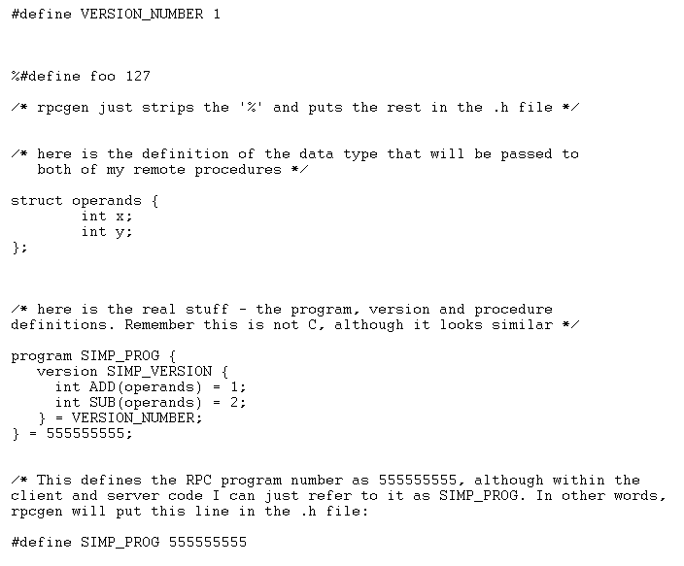
simp.x

Slide 92
RPC Programming Steps
1- Create interface definition file
2- Program the client
Create "RPC Handle" to a server
Call client stubs
3- Program the server
Write remote procedure that do the work

Slide 93
Unicast, Broadcast, and Multicast
Unicast - “Sending a packet to a single destination host.” TCP and UDP.
Broadcast - “A method of delivering a packet to every host on a particular network or internet. May be implemented in hardware (e.g., Ethernet) or software (e.g., IP Broadcast).” UDP only!
Multicast - “A special form of broadcast in which packets are delivered to a specified subgroup of network hosts.” (As above can be hardware or software). UDP only!

Slide 94
What happened in unicast?
When the IP layer processes the packet, the packet is accepted only if the destination address matches one of its own IP addresses.
Then the IP layer looks at the protocol field in the IPv4 header and the datagram is passed to UDP if the protocol is UDP.
Then the UDP layer looks at the destination port (and possibly the source port, too, if the UDP socket is connected), places the datagram onto the appropriate socket receive queue.
A unicast IP datagram is received by only the one host specified by the destination IP address.

Slide 95
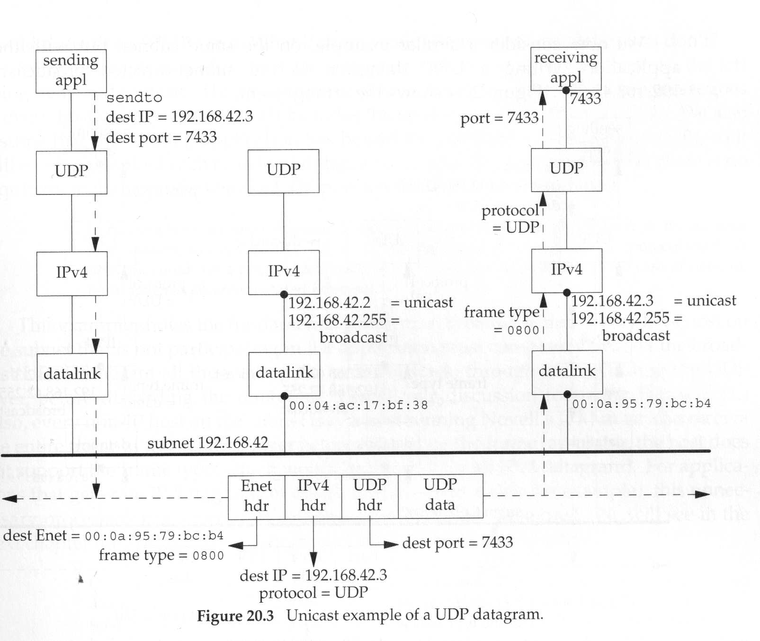
Unicast of a UDP datagram

Slide 96
What happened in broadcast?
When the host broadcasts the datagram, it notices that the destination IP address is the subnet-directed broadcast and maps into proper Ethernet address.
The hosts on the subnet all have IP addressed matching the destination address, so datagram is passed to UDP layer when the protocol field is 17.
Nothing special needs to be done by an application to receive a broadcast UDP datagram: it just creates a UDP socket and binds the application’s port number to the socket.

Slide 97
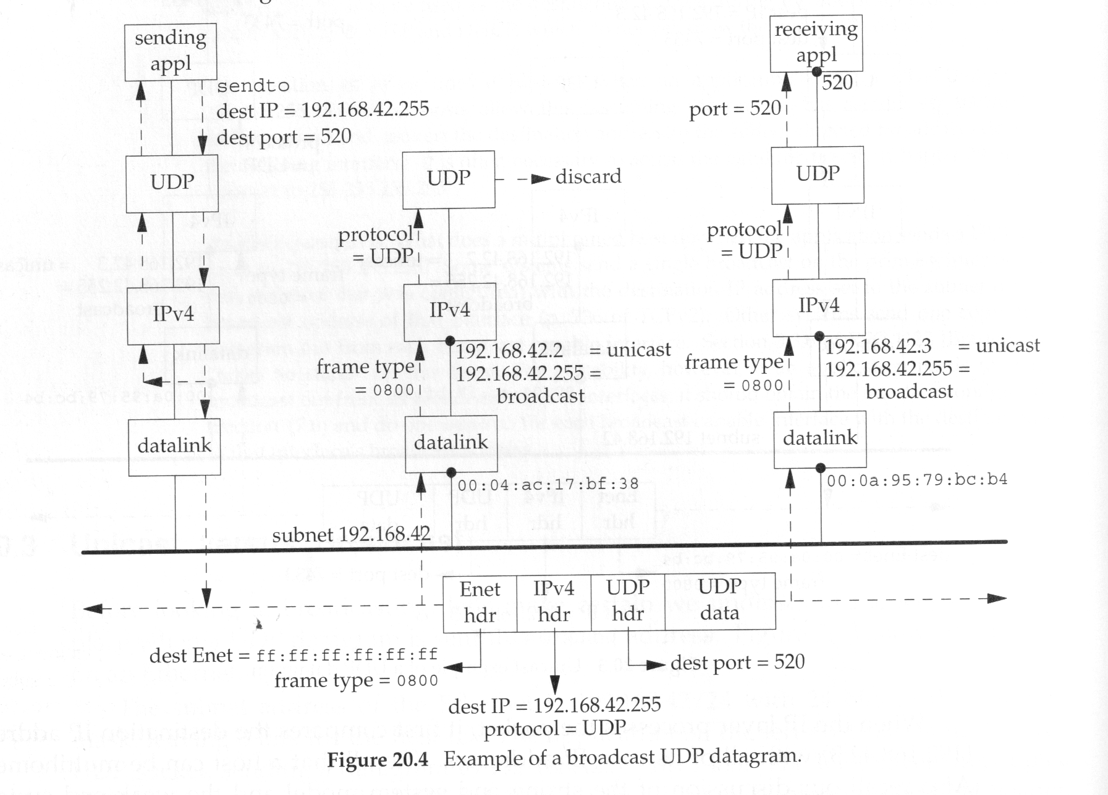
Broadcast of UDP datagram

Slide 98
Problem with Broadcast
Every IPv4 host on the subnet that is not participating in the application must also completely process the broadcast UDP datagram all the way up the protocol stack, through and including the UDP layer, before discarding the datagram.
Also, every non-IP host on the subnet also receive the entire frame at the datalink layer before discarding the frame.
For applications that generate IP datagrams at a high rate (audio or video), this unnecessary processing can severely affect these other hosts on the subnet.

Slide 99
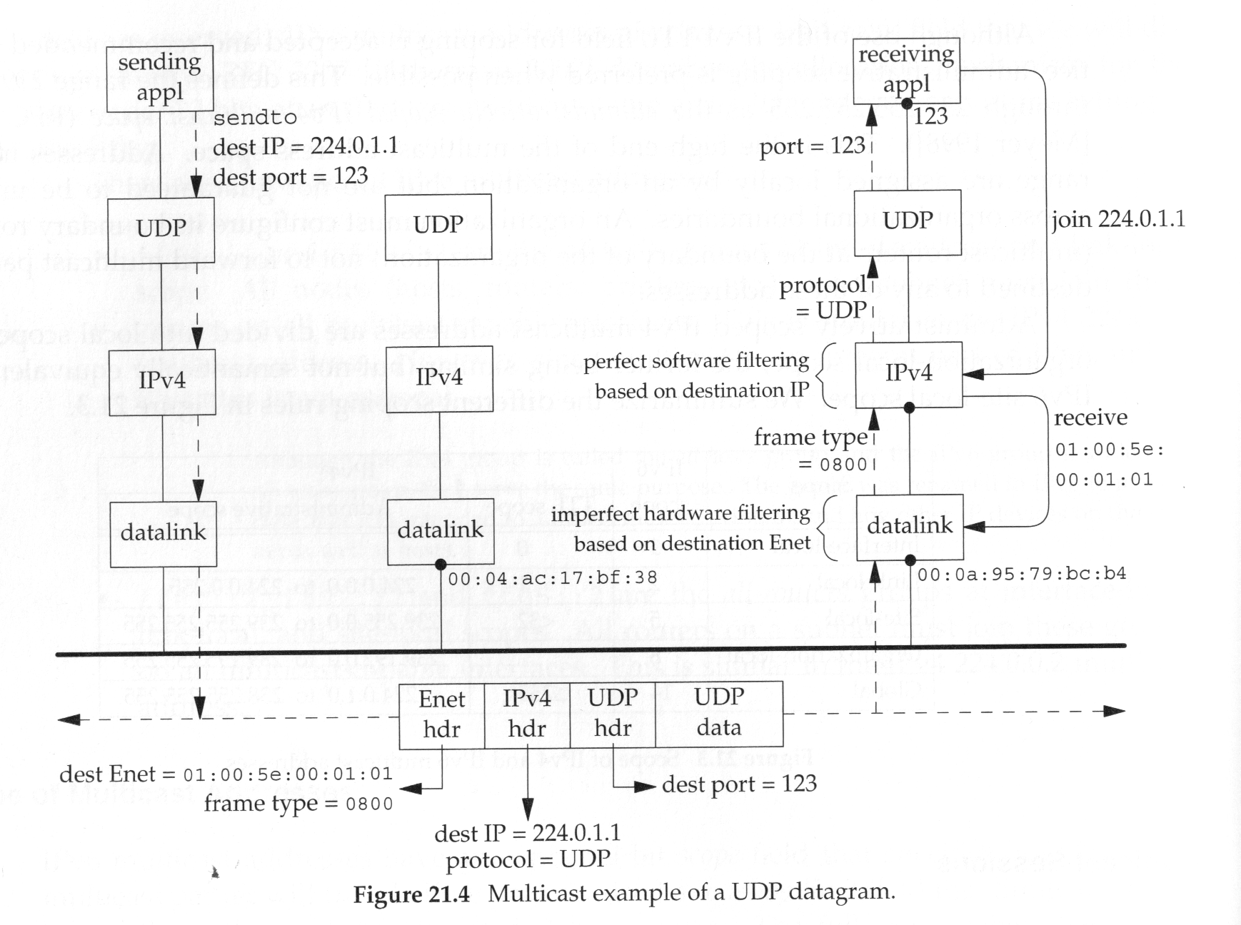
Multicast of UDP Datagram

Slide 100
What are the benefits of multicast routing?
Conferences
  Efficient distribution of live (or prerecorded -- net TV) event, or video/audio on demand if we accumulate requests over a time interval. Only a single copy of a packet on a link -- contrast to RealAudio broadcast of World Series using unicast.
  Can be single source and multiple destinations, multiple sources and multiple destinations, multiple media (e.g., audio, video, white board).
  Combine with hierarchical coding
Transmitting files to multiple destinations
  Can send separate copy to each destination
  Multicast can be more efficient as it only sends a single copy on each link. (the following could benefit Pointcast, Netscape Netcaster, MS IE Active Channels, Usenet news, updating mirrors)

Slide 101
Getting the GET
If the request method is GET:
if (strcasecmp(method,”get”)==0)
The next step is to get the query string from the environment variable QUERY_STRING
char *query;
query = getenv(“QUERY_STRING”);

Slide 102
Send back http Response and Headers:
The CGI program can send back a http status line :
printf(“HTTP/1.1 200 OK\r\n”);
and headers:
    printf(“Content-type: text/html\r\n”);
    printf(“\r\n”);

Slide 103
Important!
A CGI program doesn’t have to send a status line (the http server will do this for you if you don’t).
A CGI program must always send back at least one header line indicating the data type of the content (usually text/html).
The web server will typically throw in a few header lines of it’s own (Date, Server, Connection).

Slide 104
Simple GET handler
int main()
{
char *method, *query;
method = getenv(“REQUEST_METHOD”);
if (method=NULL) … /* error! *
{
}
else if (strcasecmp(method, “get”)==0)
{
    query = getenv(“QUERY_STRING”);
    if(query ==NULL)
    {
    }
    else
    {
printf(“Content-type: text/html\r\n\r\n”);
printf(“<H1>Your query was %s</H1>\n”, query);
return(0);
}
}
}

Slide 105
CGI reading POST
If REQUEST_METHOD is a POST, the query is coming in STDIN.
The environment variable CONTENT_LENGTH tells us how much data to read.

Slide 106
Possible Problem
char buff[100];
char *clen = getenv(“CONTENT_LENGTH”);
if (clen==NULL)
/* handle error */
int len = atoi(clen);
if (read(0,buff,len)<0)
… /* handle error */
pray_for(!hacker);

Slide 107
CGI Method summary
GET:
  REQUEST_METHOD is “GET”
  QUERY_STRING is the query
POST:
  REQUEST_METHOD is “POST”
  CONTENT_LENGTH is the size of the query (in bytes)
  query can be read from STDIN

